Slide 1
Fundamentals of Machine Learning
Prepared by
Prince Thomas M.E., PhD
Associate Professor

Slide 2
Chapter 5: Reinforcement Learning
Introduction to Reinforcement Learning
Definitions: Agent, Environment, Action, Reward, and Policy
Exploration vs. Exploitation
Reinforcement Learning Problem Setup
Markov Decision Processes (MDPs)
Value Function, Policy Function, and Bellman Equation
Q-Learning Algorithm
Q-Table and Update Rule
Temporal Difference Learning

Slide 3
5.1 Introduction to Reinforcement Learning
Reinforcement Learning (RL) is a type of machine learning where an agent learns to make decisions by taking actions in an environment to maximize cumulative reward. Unlike supervised learning, where the model is trained on labeled data, RL relies on the agent's interactions with the environment and feedback in the form of rewards or penalties.
Definitions
Agent: An agent is the learner or decision-maker in the RL framework. It interacts with the environment by taking actions and receiving feedback in the form of rewards.
Environment: The environment encompasses everything that the agent interacts with. It defines the context in which the agent operates and responds to the agent's actions.

Slide 4
Action:
An action is a choice made by the agent that affects the state of the environment. Actions can be discrete (e.g., moving left or right) or continuous (e.g., varying the speed of a robot).
Reward:
A reward is a scalar feedback signal received by the agent from the environment after taking an action. It indicates the immediate benefit of the action taken, guiding the agent toward optimal behavior.
Policy:
A policy is a strategy that the agent employs to determine its actions based on the current state of the environment. It can be deterministic (a specific action for each state) or stochastic (a probability distribution over actions).

Slide 5
Exploration vs. Exploitation:
In Reinforcement Learning, the agent faces a perpetual dilemma: should it stick to what it knows (exploitation) or venture into the unknown (exploration)? This trade-off is crucial for optimal learning and decision-making.
Exploration
Definition: Trying new actions or strategies to discover potentially better rewards.
Goal: To expand the agent's knowledge of the environment and identify new opportunities.
Benefits:
Can lead to the discovery of optimal policies.
Helps the agent adapt to changing environments.
Drawbacks:
Can lead to suboptimal performance in the short term.
Requires more computational resources.

Slide 6
Exploitation
Definition: Using the current knowledge to maximize immediate rewards.
Goal: To leverage the agent's existing understanding of the environment.
Benefits:
Can lead to immediate rewards.
Is computationally efficient.
Drawbacks:
Can lead to suboptimal performance in the long term.
Can prevent the agent from discovering better strategies.

Slide 7
Balancing Exploration and Exploitation
The key to successful reinforcement learning is to strike a balance between exploration and exploitation.
Various techniques can be employed to achieve this:
Epsilon-Greedy:
Upper Confidence Bound (UCB):
Thompson Sampling:
Contextual Bandits:

Slide 8
5.2 Reinforcement Learning Problem Setup
The RL problem is typically defined in terms of an agent interacting with an environment over discrete time steps. At each time step:
The agent observes the current state of the environment.
The agent selects an action based on its policy.
The action affects the environment, moving it to a new state.
The environment provides a reward to the agent.
This cycle continues as the agent seeks to maximize its cumulative reward over time.

Slide 9
Markov Decision Processes (MDPs)
MDPs provide a formal framework for modeling decision-making in RL. An MDP is defined by a tuple (S,A,P,R,γ).
States (S): A set of all possible states in the environment.
Actions (A): A set of actions available to the agent.
Transition Function (P): A probability distribution that describes the likelihood of moving from one state to another given an action.
Reward Function (R): A function that defines the expected reward received after transitioning from one state to another due to an action.
Discount Factor (γ): A factor between 0 and 1 that determines the present value of future rewards.
Markov Property: The future state depends only on the current state and action, not on past states.

Slide 10
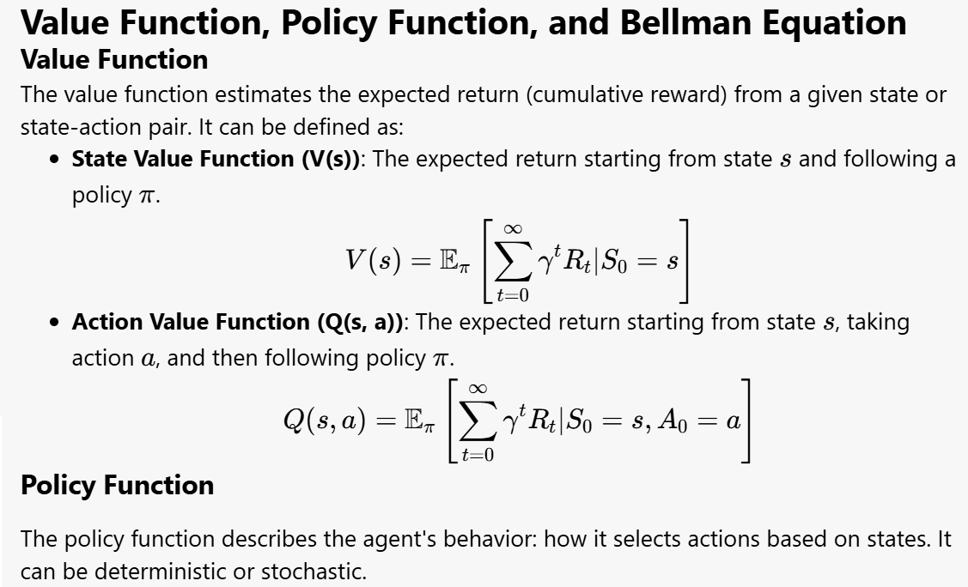

Slide 11
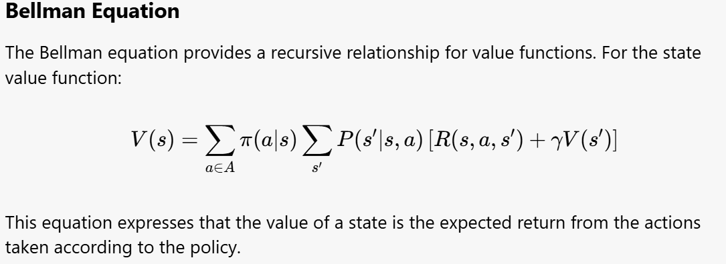

Slide 12
5.3 Q-Learning Algorithm
What is Q-Learning?
Model-Free: Learns optimal policies without requiring a model of the environment.
Off-Policy: Learns the value of the optimal policy independently of the agent's actions.
Versatile: Applicable to a variety of problems with different state and action spaces.
Why Q-Learning is Needed
Efficiency: Can learn optimal policies through exploration and experience.
Flexibility: Suitable for both discrete and continuous action spaces.
Convergence: Guarantees convergence to the optimal policy under certain conditions.

Slide 13
Steps in the Q-Learning Algorithm
Initialize Q-Table:
Create a Q-table with dimensions for state-action pairs.
Initialize all values to zero or small random numbers.
Choose Action:
Use an exploration strategy (e.g., ε-greedy) to select an action.
Take Action:
Execute the chosen action in the environment.
Observe Reward:
Receive the reward from the environment based on the action taken.
Update Q-Value:
Apply the Q-learning update rule to adjust the Q-value for the state-action pair.
Repeat:
Continue the process for a specified number of episodes or until convergence.

Slide 14
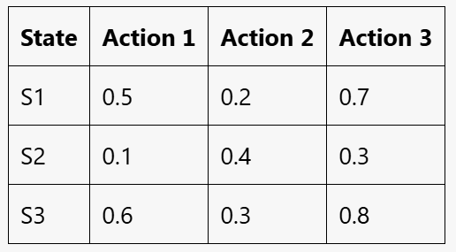
What is a Q-Table?
A Q-Table is a data structure used to store the Q-values for each state-action pair in a reinforcement learning environment.
Each entry in the Q-table represents the expected utility (or quality) of taking a particular action in a given state.
Structure of a Q-Table
The table has rows corresponding to different states and columns corresponding to actions.
Each cell Q(s,a) contains the value representing the expected cumulative reward from taking action a in state s and following the current policy thereafter.
Example:
How to Use a Q-Table
The agent uses the Q-table to decide which action to take in a given state. It typically selects the action with the highest Q-value, balancing exploration and exploitation.

Slide 15

What is the Update Rule?
The update rule in Q-learning is used to adjust the Q-values in the Q-table after the agent takes an action and observes the outcome.
This rule enables the agent to learn from its experiences and improve its policy over time.
Formula
Parameters:
Q(s,a): Current Q-value for state s and action a.
α: Learning rate (0 < α ≤ 1).
R: Reward received after action a in state s.
γ: Discount factor (0 ≤ γ < 1).
s′: New state resulting from action a.
max⁡a′Q(s′,a′): Maximum Q-value for new state s′.

Slide 16
Temporal Difference (TD) Learning
Definition: A reinforcement learning method that updates value estimates based on the difference between predicted values and actual rewards received.
Combination: Merges concepts from dynamic programming and Monte Carlo methods.
Key Features
Value Function:
State Value Function V(s): Estimates expected return from being in state s.
Action Value Function Q(s,a): Estimates expected return from taking action a in state s.

Slide 17
Update Mechanism:
TD Update Rule: V(s) ← V(s) + α[ R + γV(s′) − V(s) ]
R: Reward received after taking an action.
γ: Discount factor (0 ≤ γ < 1) for future rewards.
s′: Next state after taking an action.
α: Learning rate (0 < α ≤ 1).
Bootstrapping:
Updates estimates based on other learned estimates, allowing for efficient learning without waiting for final outcomes.

Slide 18
Advantages
Efficiency: Updates are made at each step, allowing for quicker learning compared to Monte Carlo methods.
Online Learning: Effective in environments with delayed rewards, updating values as new information is received.
Applications
Commonly used in various reinforcement learning tasks, including:
Game playing (e.g., chess, Go).
Robotics (e.g., navigation, manipulation).
Control problems (e.g., autonomous vehicles).
TD Learning is a foundational technique in reinforcement learning, enabling agents to learn optimal policies through direct interaction with their environments.

